Slide 1

Employee Data Analysis using Excel
STUDENT NAME : ARTHI M
REGISTER NO : 312206305
DEPARTMENT : B.COM (ACCOUNTING & FINANCE)
COLLEGE : S.S.K.V COLLEGE OF ARTS & SCIENCE
FOR WOMEN

Slide 2
PROJECT TITLE
Employee Performance Analysis
using Excel

Slide 3

AGENDA
Problem Statement
Project Overview
End Users
Our Solution and Proposition
Dataset Description
Modelling Approach
Results and Discussion
Conclusion

Slide 4


PROBLEM STATEMENT
Identifying areas of improvement
Providing feedback
Planning for career development
Increasing productivity
Improving communication

Slide 5


PROJECT OVERVIEW
Employee performance analysis involves evaluating various metrics such as productivity, efficiency, and output quality to assess individual and team performance.
By leveraging data analytics, organizations can identify top performers, areas for improvement, and potential training needs.

Slide 6

WHO ARE THE END USERS
HR
MANAGERS
END USERS
EMPLOYERS

Slide 7
OUR SOLUTION AND ITS VALUE PROPOSITION
• CONDITIONAL FORMATTING
To highlight the missing values
• FILTER
To remove the missing values
• FORMULAE
To calculate the employee performance level
•
PIVOT TABLE
To give a summary of the employee performance
•
GRAPH
For visualize the data of the employee performance

Slide 8
Dataset Description
This dataset includes important attributes of the various business units, process and the productivity of the employees which had been collected manually and also been validated by the organization experts.
It has the following contents on the excel sheet to analyse the performance of the employees
Employee ID
First name
Last name
Employee type
Pay zone
Gender
Employee status
Employee classification type Current employee rating Employee performance level

Slide 9
THE "WOW" IN OUR SOLUTION
In this project I used the formulae to analyse the performance level of the employees by using current employee rating
=IFS(Z2>=5,"VERY HIGH",Z2>=4,"HIGH",Z2>=3,"MEDIUM",TRUE,"LOW"

Slide 10
MODELLING
▪ COLLECTION OF DATA
1. The data is collected from the Edunet dashboard to analyse the performance of the employees in the organization.
▪ CONDITIONAL FORMATTING
1. Conditional formatting is used to identify how much null values or empty values in the data set.
2. Here are some steps for using conditional formatting in Excel
❖ Select the random of cells, table, or sheets you want to format
❖ click the home tab
❖ click conditional formatting
❖ select manage rules
❖ click the new rule icon, which looks like a plus sign (+)
❖ select the rule type and customize the condition if needed
❖ select the formatting style
❖ click done

Slide 11
➢ FILTER
1. Filtering option in excel used to remove the missing values in the data set to analyse the performance level of employees better.
2. Here are some steps for using filter option in excel
• select the cells that you want to remove the missing values
• on the home tab, select the sort and filter option on the right corner
• Then select the option filter by colour and then click on no fill option in the selected cell to filter out the missing values in the data set.
➢ PIVOT TABLE
1. Pivot table are useful tool for analysing employee performance data because they can help with summarizing large data set and managing employee data.
2. Here are some steps for using pivot table in excel
o Select a table or range of data in the sheet
o Select Insert > Pivot table
o Drag the item into the values section twice
o Set the summarize values by and show values as options for each one.

Slide 12
GRAPH
1. Using graph in excel makes the data more presentable and easy to understand. By looking at the chart itself one can draw certain inferences or analysis.
2. It helps in summarizing a very large data in a very crisp and easy manner.
3. Here are some steps for using graph in excel
❑ Select the pivot table that you want to insert graph
❑Then click on insert tab and choose a graph type that you want to insert
❑The graph will arrive on the desired excel sheet to analyse the performance of the employees in the organization.

Slide 13
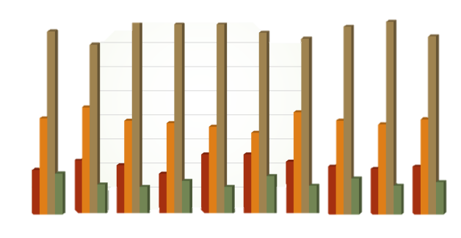
RESULTS
EMPLOYEE PERFORMANCE ANALYSIS
90
80
HIGH
LOW
MEDIUM
VERY HIGH
60
40
20
0
BPC
CCDR
EW
MSC
NEL
PL
USA
PYZ SVG TNS WB
PL
IND

Slide 14
CONCLUSION
Employee performance analysis using excel has been implemented to cater the needs of company employees and administrative people of the company in submitting appraisals, evaluating the appraisals, calculating the average ratings of the employees and finally generating the consolidated ranks effectively with role based access.
The resultant data will be used by our model to analyse and predict the performance levels of new individuals thus making the recruitment process simpler.
An excel based employee performance rating card and dashboard is very useful and adaptable tool.
It can significantly enhance your performance management process.

Slide 15


